Slide 1
Collecting and Using School Data to Improve Student Health and Academic Outcomes – A Collaborative Model
Presenters:
Bruce K. Meisinger, MPP
Director of Public Health,
Black Hawk County Health Department
Bradley M. McCalla, MS, Ed.S.
Executive Director, SuccessLink

Slide 2
Policy Background: Why we share school data?
More effectively/accurately track student health:
Directly measured BMI:
Across all grade levels
Gender/demographic parameters
Large sample size throughout whole school district
Increasing scope and complexity of student chronic disease management by school nurses (diabetes, asthma, hypertension,…)
Track and Improve student achievement:
High absenteeism/high dropout rate/low graduation rate
Gaps in student academic performance
Identify areas for effective preventive intervention by school and community intervention strategies.

Slide 3
Policy Issue: How we share school data?
Black Hawk County Health Department provides:
School Nursing Services (contracted) to:
Waterloo Community School District (enrollment 10,500)
Cedar Falls Community School District (enrollment 5,000)
Tri-County Head Start
School-based Clinics (Success Street) under a Nurse Practitioner model in 2 Waterloo high schools and 1 middle school with re-positioned collaborating agency services
Student Health Services (Clinic) to Hawkeye Community College using similar “Success Street” model
Total student population served is large, diverse, dispersed across large metro area/Data difficult to access from multiple IT environments and layers of privacy and confidentiality restrictions

Slide 4
The SuccessLink Collaborative Model
SuccessLink (formerly Communities In Schools)
501(c)3 Nonprofit community agency
Serves as the broker of community services in local school systems (Waterloo, Hawkeye Community College)
Success Street School-based Clinics
Primary Care – Black Hawk County Health Department
Mental Health Services- Black Hawk Grundy Mental Health
Substance Abuse Counseling – Pathways Behavioral Health
Women’s Health Services – Allen Women’s Health Center
Facilitates data sharing between school districts, public health and community agencies.

Slide 5
Collaborative Structure of the SuccessLink Model & Data Sharing
SuccessLink Success Street School Clinics
Waterloo Community School District
Women’s Health Services
Substance Abuse Counseling
Mental Health Counseling
BHC Health School Nursing/ Primary Care
Community Groups Serving Student Population Using Data

Slide 6
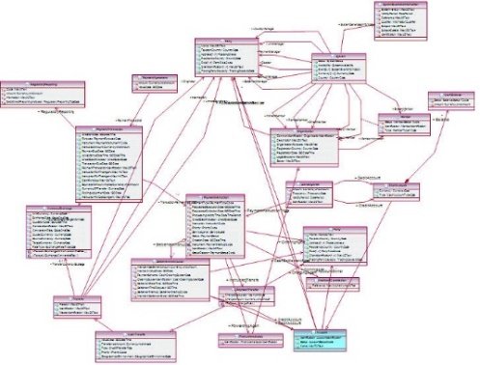
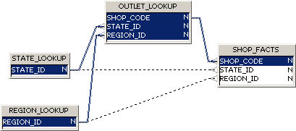
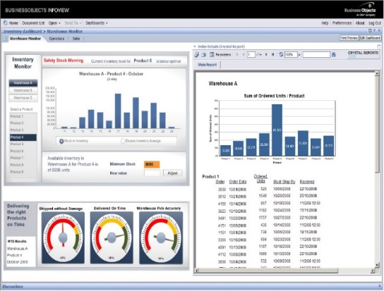
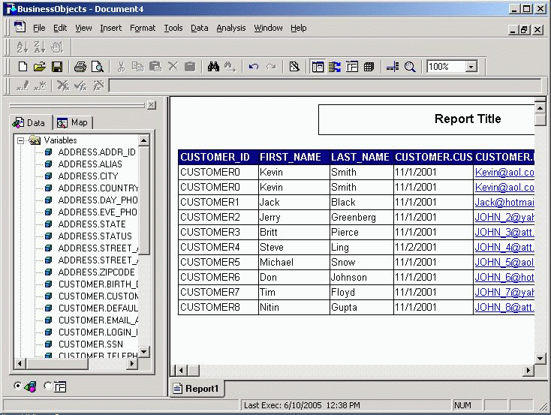

Slide 7
How School BMI Data Is Used

Slide 8
How School BMI Data Is Used
BMI - % Waterloo K-10 > 85th Percentile(Overweight or Obese)

Slide 9
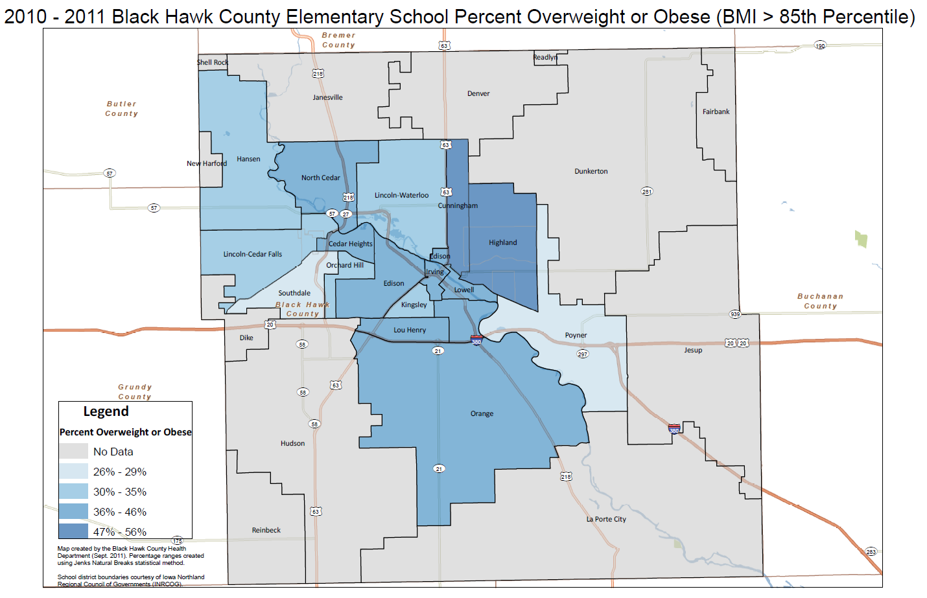

Slide 10
How School BMI Data Is Used
Public Health (Black Hawk County Health Dept.)
Community Health Needs Assessment (CHNA) Indicator
Health Improvement Plan (HIP) - planning prioritization factor
Grant seeking – needs assessment data
Community Funders and Service Agencies
Cedar Valley United Way – prioritization of funding allocation among child/adolescent health and wellness project applications
Community agencies providing health/wellness service programming for child/adolescent populations (YMCA/YWCA/Boys & Girls Club)
Public Awareness Efforts
Frequently cited media talking point regarding childhood obesity.
Major factor in Waterloo’s selection as a Blue Zone Project site.

Slide 11
How Student Outcome Data Is Used
Partnering agencies (e.g. YWCA, Boys & Girls Club, Boy Scouts, Food Bank, Head Start) use this data system to measure:
GPA
Attendance rates
Behavior referrals
Specific academic areas (reading, math, science)
Extracurricular activities
Agency program participants are measured over time against themselves, the entire student population or a subset of the student population.
School Data
Connected by
Agency Data
ID, Name, DOB

